Slide 1
Victorian public service agreement
VBC Bargaining update
March 2024
Karen Batt
CPSU Victorian Branch Secretary

Slide 2
Bargaining commenced September 2023
Weekly meetings up to Christmas.
After Xmas break negotiations resumed with an independent facilitator provided in the renegotiation clause – former FWC Commissioner Julius Roe
CPSU wants to reach agreement as close to the current agreement nominal expiry date (20 March 2024)
Want to get money into members pockets
Want to avoid expensive lengthy litigation
Clause 3.5 sets out renegotiation period

Slide 3
Bargaining commenced September 2023
Key issues identified:
Salary increase
4 Day working week trial
VPS5-7 overtime compensation
VPS agreement common policies and BPEC compliance
Gender pay equality

Slide 4
Other bargaining issues
Negotiations have reached a point where we need to consider whether a settlement can be reached
Discussions continue on matters the parties believe they can agree to.
Separate discussions occurring with Departments/agencies with Appendices
Mainly technical changes, clarifications and removing possible ambiguity

Slide 5
Pay increase
CPSU asked for 20% over the life of a 4 year agreement
What’s been negotiated
4 x 3.0% pa increase. Effective dates to be agreed
4 annual pay increases (7%, 5%, 4% and 4%)
Mobility payments retained from 2020 Agreement (approx. 1.25% superable allowance paid annually (1 July)
Lump sum bonus. Approx. $5500 per EFT employee. Pro rata for part time.
Progression pay retained
Top of band/value range bonus retained (1%)
4 year agreement 2024-2028

Slide 6
3% per annum x 4
+ 1.25% pa mobility payments retained
+ Progression payments retained (approx. 2% pa or 1% top of band)
+ ‘cost of living payment’ Approx. $5500 per EFT employee (pro rata for part time)
= effectively an additional 5.5% for employee salary of $100,00 (eg VPS 4.1.5 = $100,619 eff. 1-12-2023)
What’s the pay offer worth
= effective 4.25%

Slide 7
Four day working week trial
What’s being discussed
Parties still discussing how a trial might work
CPSU claimed a 4 day reduced working hours to be trialled in VPS
Want a pilot to explore all the issues

Slide 8
Gender Equality – Negotiated outcome
Payments for parental leave
Superannuation for up to 104 weeks paid and unpaid leave for primary carer agreed
Gender affirmation leave
Previously gender transition leave
Clause redrafted to be fit for purpose
Salary rate for shift workers taking parental leave increased (exact mechanism to be resolved)

Slide 9
Gender Equality – Negotiated outcome
Reproductive leave to assist people experiencing symptoms associated with Endometriosis, PCOS, and complicated pregnancies.
Additional reproductive leave
Leave can also be used for fertility treatments (IVF)
Details still to be resolved

Slide 10
Overtime compensation – VPS5-7 and equivalent
Higher classifications precluded from overtime payment.
Work overload due to staff cuts
Service delivery expectation outside traditional working week
Exploitation of working from home flexibility
Clearer guidance is needed for when overtime requests are reasonable
Reinforce employee rights to refuse overtime when it is unreasonable
Not unique to VPS. Applies in other states and Federal public service
Time off in lieu (TOIL) at employer discretion

Slide 11
Government position
Additional hours can be expected of higher paid employees
Overtime payment would need to be paid for from Government pay policy
This would reduce the pay offer
CPSU objected to view that salaries already include overtime component

Slide 12
What’s been negotiated
New guidance about what is reasonable eg requiring you to work when you have Taylor Swift tickets would not be reasonable
Work needs to be arranged to the hours employees are paid
Clause 14 - workload review applies
Time in lieu will apply in some circumstances
For first time overtime arrangements for VPS5-7 and equivalent classifications will be set out in BPEC
Right to disconnect from FW Act will be included in agreement
Clarify which agreement clauses will also apply
TOIL will apply in some circumstances and will be paid out at salary level when accrual limit reached (still to be determined)

Slide 13
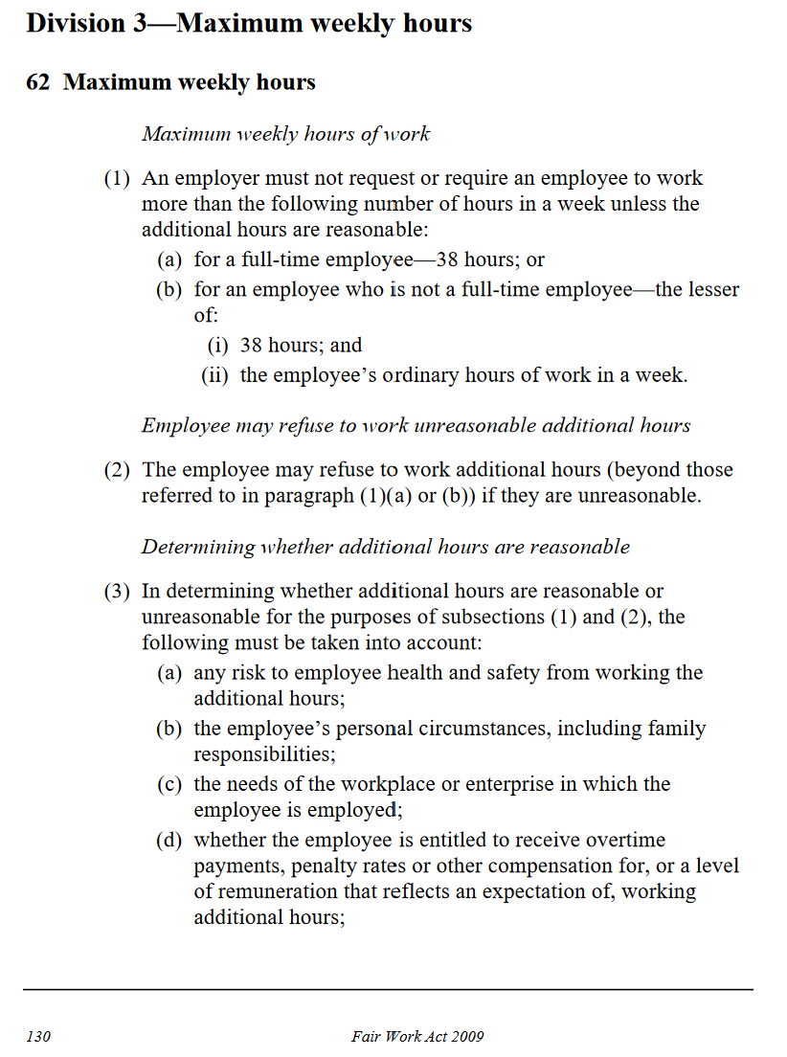
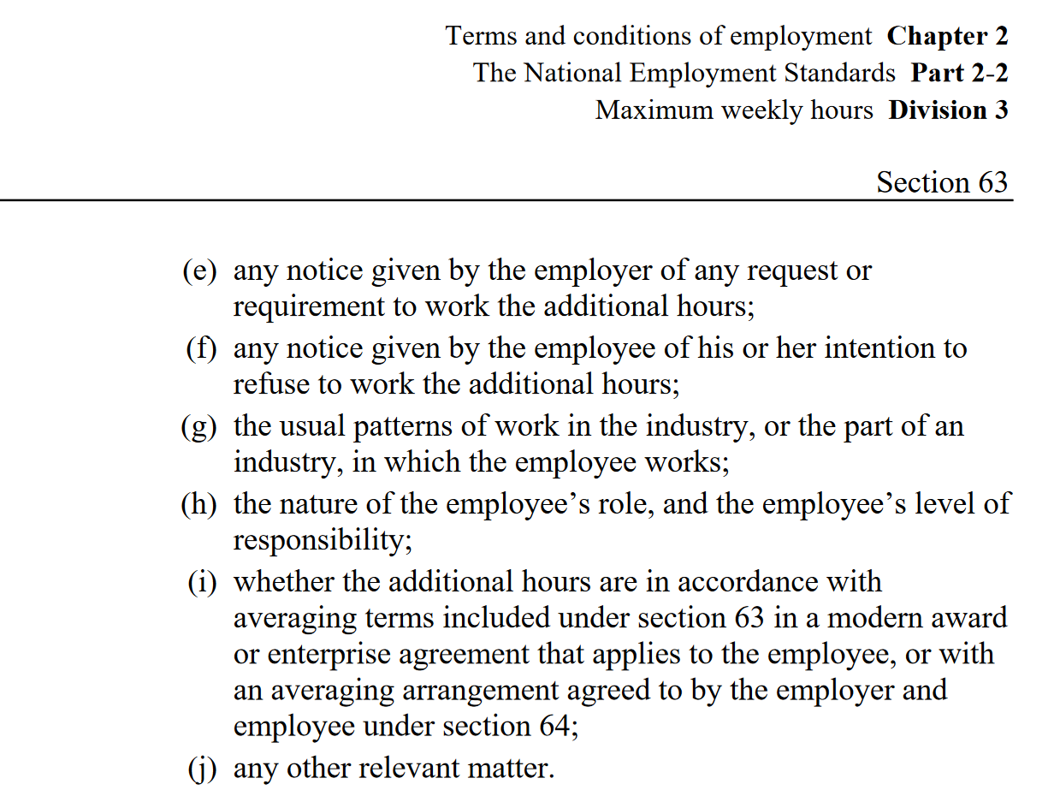
Clause 41.3 – Reasonable hours of work - will be strengthened to include all the factors is FW Act s62(3) relevant for determining whether a request to work additional hours is reasonable

Slide 14
BPEC (Best Practice Employment Commitment) and Common policies
What’s been achieved
Clause 4 will set out the intent that the policies will apply to reduce disputes and provide consistent application of the agreement
BPEC and common policy commitments strong evidence if matter was subject to dispute
Policies do not normally form part of an enterprise agreement.
Rights reserved to use dispute settlement procedure where necessary
Since 2016 agreement common policies developed to provide consistent implementation of the agreement
Departments/agencies applied there own interpretation

Slide 15
Other negotiated changes to agreement
Update agreement for legislative change
FW Act has more protection for fixed term and casual employees.
Delegate rights. FW Act provides protections for delegates. Agreement clauses amended to ensure compliance
Right to disconnect added to agreement
Fixed term employment conversion process.

Slide 16
Other negotiated changes to agreement
Improved agreement terms
Personal/carer leave evidence requirements change from medical certificates to “evidence that would satisfy a reasonable person”
Improved service continuity between fixed term contracts and new starts
Casual conversion clause (and fixed-term conversion TBC)
Requiring the employer to consider Flexible Working Arrangement and WFH requests
Recognition of previously attained Classification increment for salary purposes when employee returns to VPS in similar role.

Slide 17
Options if no agreement
FWC can arbitrate if both union and employer consent
Consent arbitration – s240
Employers rarely agree. Victoria has never agreed in past
Protected Industrial Action – s437
FWC order and ballot to approve action. Only union members can vote. Can take 6-8 weeks.
Majority vote for actions AND majority to participate in a ballot
FWC can only arbitrate after bargaining terminated due to health and safety or economic impact of action
No backdating. New conditions unlikely
Intractable bargaining declaration – s234
Needs more than 9 months bargaining without agreement

Slide 18
Impact of Victorian Government pay policy
Government pay policy affects bargaining
Victorian Government will not change its policy
All public sector unions when bargaining need to deal with this issue. Firefighters, Police, and Ambos dealing with this now. Nurses and Teachers bargaining commences later in 2024
CPSU wants to get money in members pockets as soon as possible
without wasting members money on expensive and lengthy litigation in the Courts
Costing members money for taking industrial action

Slide 19
How wages policy is dealt with by FWC
[207] In our view, the Victorian Government’s wages policy is relevant to our consideration of the level of wage increases to be included within the workplace determination. The policy is, of course, not determinative of that issue, however, given the size of the state government sector and the role of the government in allocating scarce resources to various public services (such as health, education and justice) it is appropriate to accord the policy more weight than one would to the negotiating position of parties without such responsibilities. Of course, such a policy cannot displace the Commission’s consideration of the range of statutory factors to which it must have regard.
Parks Victoria v The Australian Workers' Union and others
[2013] FWCFB 950 11 February 2013

Slide 20
United Firefighters’ Union of Australia v Fire Rescue Victoria T/A FRV [2024] FWCFB 43 - 5 February 2024
[161]The existence of the Victorian Government’s wages policies in force from time to time is a “notorious fact” that industrial bargaining parties in Victoria affected by those policies can be taken to know about. While it is true that employee bargaining representatives are not directly subject to those wages policies, the policies permeate industrial bargaining with Victorian Government agencies because the Government agencies are bound by them.
[162]In any case, the evidence demonstrates that from at least August 2022, FRV did make clear statements indicating that compliance with the wages policy was required. In August 2022, following the lodgement of the UFU’s Efficiencies Application, FRV explainedin bargaining that Government approval was required in relation to all matters, including non-wages related matters.“

Slide 21
What happens next?
Facilitated discussion have canvassed all the issues
If there is in principle agreement formal Government approval will be sought
Victorian Branch Council will decide whether to accept
Heads of agreement is signed between parties to complete agreement and lock in operative dates
Ballot process under FW Act requires vote of all employees covered by the agreement
Determine how Appendices to be resolved. In past where no agreement status quo retained

Slide 22
Non agreement increases
From 1 July 2024, the Superannuation Guarantee (SG) rate rises from 11% to 11.5 % for 2024/25
From 1 July 2025, the Superannuation Guarantee (SG) rate rises from 11.5% to 12 % for 2025/26
From 1 July 2024, the proposed tax cuts will:
reduce the 19 per cent tax rate to 16 per cent.
reduce the 32.5 per cent tax rate to 30 per cent tax between $45,001-$135,000
increase the threshold above which the 37 per cent tax rate applies from $120,000 to $135,000

Slide 23
Thanks for your attendance and contributions

